Slide 1
Problem: Video Game Burnout
Notes:
Amin: (1-2min)
Ask a question based on the problem
Talk about “Video Game Burnout” - link for more info on that(https://www.gamersnexus.net/gg/747-preventing-gaming-burnout-games-are-boring) , maybe give example of yourself getting bored playing video games
Hand it over to me, **mention that i’m going to talk about the solution

Slide 2

Notes:
Amin: (1-2min)
Ask a question based on the problem
Talk about “Video Game Burnout” - link for more info on that(https://www.gamersnexus.net/gg/747-preventing-gaming-burnout-games-are-boring) , maybe give example of yourself getting bored playing video games
Hand it over to me, **mention that i’m going to talk about the solution

Slide 3
Notes:
Hrithik: (<10s)
Introducing Endless

Slide 4


+
Notes:
Hrithik: (1-2min)
Talk about what the AI does and how it works
Hand it over to Mark, who will give a demonstration

Slide 5
Website
Notes:
Amin: (30s-1min)
Mention: we are fun to work with, we are passionate about our ideas, and we will make you rich
Add anything else that you want to

Slide 6
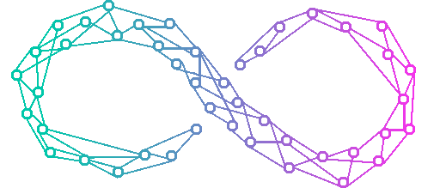



Notes:
Salima: (1 min)
Talk about who Endless connects
So first mention the consumer, and what impact it has on them
Then, the gaming community and professional gamers
And lastly, ai research teams likes Google’s DeepMind (talk about their significance, and provide maybe one more example of another AI research group (ex. IBM))

Slide 7
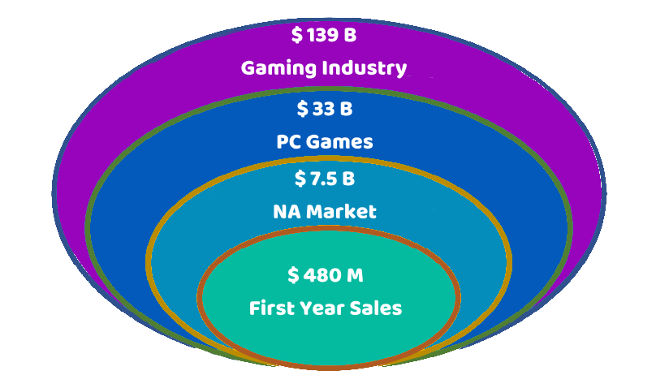

Data provided by
Notes:
1% of gamers in NA * 200 m(total gamers) * 240(revenue made from one gamer for a year)
Amin: (1 min)
Talk about the numbers
So discuss that we took a “Bottom Up” approach to evaluate our product idea.
Go through the top three
Mention for the first year we are only targetting pc games and the NA market, and will eventually roll out to other regions and gaming platforms
When you get to the last one, go over our pricing scheme, $20/personal/2 games/month, $75/professional/10 games/month
Use the above formula to describe how we came up with the last figure

Slide 8








New Content Per Iteration
Smaller
Range
of
Products
Greater
Range
of
Products
Same Content Per Iteration
Notes:
Arunasva: (1 min)
Talk about the graph and what the axises mean
Go through few examples and explain why they are placed there
Focus on what makes Endless different and why that is important to the problem

Slide 9
Development
Closed Release
Product Launch
2020
2022
2019
2021
2023
Testing
Business
Notes:
Hrithik: (1 min)
Go through this thing

Slide 10
Why should you get involved?
Notes:
Amin: (30s-1min)
Mention: we are fun to work with, we are passionate about our ideas, and we will make you rich
Add anything else that you want to

Slide 11
$ 0
+ Mentorship
Notes:
Mark: (15 s)
Say what we want from the investors

Slide 12
Thank you for your time.
Any Questions?
Notes:
Mark: 10s
Thank you for your time!
Any questions?

